Slide 1


Data Analyst Technical Test Report
By Jafar Shodiq
j.shodiq2312@gmail.com | +6281382378203 | jafarshodiq.pythonanywhere.com

Slide 2

Index
Introduction
Feature Engineering
Data Visualization
Regression Model
New Data
Closing

Slide 3

Introduction

Slide 4
Iowa Liquor Sales
This dataset contains every wholesale purchase of liquor in the State of Iowa by retailers for sale to individuals since January 1, 2012. The State of Iowa controls the wholesale distribution of liquor intended for retail sale, which means this dataset offers a complete view of retail liquor sales in the entire state. The dataset contains every wholesale order of liquor by all grocery stores, liquor stores, convenience stores, etc., with details about the store and location, the exact liquor brand and size, and the number of bottles ordered.
In addition to being an excellent dataset for analyzing liquor sales, this is a large and clean public dataset of retail sales data. It can be used to explore problems like stockout prediction, retail demand forecasting, and other retail supply chain problems.

Slide 5
Problem Definition
Explore the dataset and see if some useful information can be extracted
Make a regression machine learning model

Slide 6
Data (1)
The original dataset can be found on public dataset Google Cloud Platform called Iowa Liquor Sales.
Table size: 5.47 GB
Number of attributes: 24
Number of instances: 20,546,005
Last update: 2021-02-05 02:21:27

Slide 7
Data (2)
For this project, we will not use all of the instances, instead a small percent is enough. But how small are we talking about?
A good maximum sample size is around 10% of the population (our original number of instances) as long as it does not exceed 1000.
10% of 20,546,005 is 2,054,600. So 1000 samples it is.
But,

Slide 8
Data (3)
But there are more things to consider when getting samples, like margin of error and confidence level.
There is a site which lets you calculate quickly how many samples do we need. We will put 95% confidence and +-2% margin error. As a result, we get 2401 ideal sample size.

Slide 9
Data Dictionary (1)
Features | Description
invoice_and_item_number | Concatenated invoice and line number associated with the liquor order. This provides a unique identifier for the individual liquor products included in the store order.
date | Date of order.
store_number | Unique number assigned to the store who ordered the liquor.
store_name | Name of store who ordered the liquor.
address | Address of store who ordered the liquor.
city | City where the store who ordered the liquor is located.
zip_code | Zip code where the store who ordered the liquor is located.
store_location | Location of store who ordered the liquor. The Address, City, State and Zip Code are geocoded to provide geographic coordinates. Accuracy of geocoding is dependent on how well the address is interpreted and the completeness of the reference data used.

Slide 10
Data Dictionary (2)
Features | Description
county_number | Iowa county number for the county where store who ordered the liquor is located
county | County where the store who ordered the liquor is located
category | Category code associated with the liquor ordered
category_name | Category of the liquor ordered.
vendor_number | The vendor number of the company for the brand of liquor ordered
vendor_name | The vendor name of the company for the brand of liquor ordered
item_number | Item number for the individual liquor product ordered.
item_description | Description of the individual liquor product ordered.
pack | The number of bottles in a case for the liquor ordered

Slide 11
Data Dictionary (3)
Features | Description
bottle_volume_ml | Volume of each liquor bottle ordered in milliliters.
state_bottle_cost | The amount that Alcoholic Beverages Division paid for each bottle of liquor ordered
state_bottle_retail | The amount the store paid for each bottle of liquor ordered
bottles_sold | The number of bottles of liquor ordered by the store
sale_dollars | Total cost of liquor order (number of bottles multiplied by the state bottle retail)
volume_sold_liters | Total volume of liquor ordered in liters. (i.e. (Bottle Volume (ml) x Bottles Sold)/1,000)
volume_sold_gallons | Total volume of liquor ordered in gallons. (i.e. (Bottle Volume (ml) x Bottles Sold)/3785.411784)

Slide 12
Feature Engineering

Slide 13
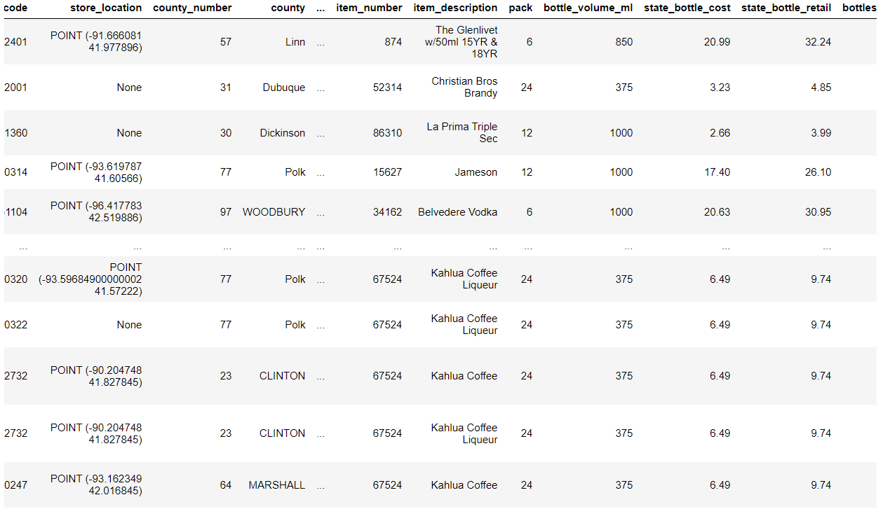
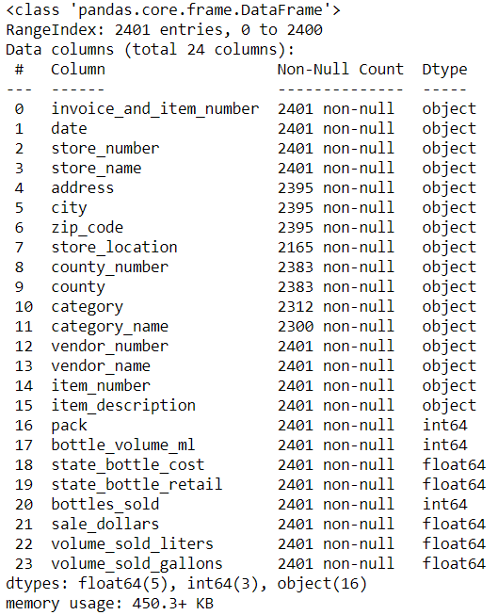
Data Overview

Slide 14
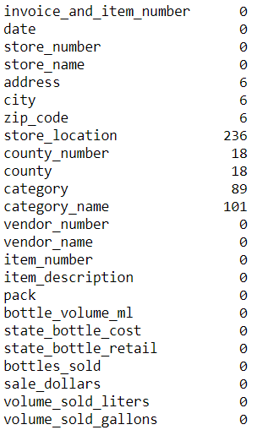
Check for Missing Values
If there was enough time, we could probably explore these missing values more and try to fill them with values that fit best. But for now, we will drop all the missing values.
Now we have 2061 instances without the missing values.
df.dropna(inplace=True)

Slide 15
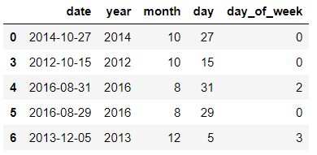
Deal with Datetime Object
The date in our data is still in string. In order to extract datetime attributes like year, month, day, and day of the week, we will need to convert the data type into datetime object.
df['date'] = pd.to_datetime(df['date'])
df['year'] = df['date'].apply(lambda x: x.year)
df['month'] = df['date'].apply(lambda x: x.month)
df['day'] = df['date'].apply(lambda x: x.day)
df['day_of_week'] = df['date'].apply(lambda x: x.dayofweek)
Monday=0 Sunday=6

Slide 16
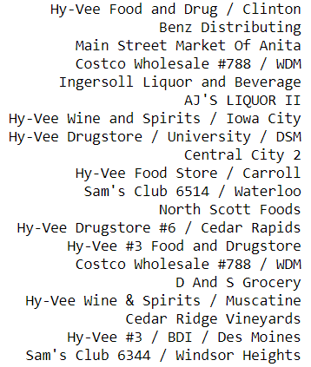
Deal with store_name (1)
This attribute originally has 581 unique values. When looking through the instances, I noticed that a same store name has one or two branches in a different city or county. The instances differ this by adding a branch number and the city where it is located. As a result, our machine will treat these instances differently.

Slide 17
Deal with store_name (2)
First, we are going to lowercase all the strings. Then, we split the strings between the store name and the city or the branch number. We will grab only the store name.
df['store_name'] = df['store_name'].str.lower()
df['store_name'] = df['store_name'].str.split(' / ').str[0]
df['store_name'] = df['store_name'].str.split('/').str[0]
df['store_name'] = df['store_name'].str.split(' #').str[0]
Next, we group all the difference branch names into one main store name.
df['store_name'].loc[df.store_name.str.contains('hy-vee')] = 'hy-vee'
df['store_name'].loc[df.store_name.str.contains('central city')] = 'central city'
df['store_name'].loc[df.store_name.str.contains("sam's club")] = "sam's club"
df['store_name'].loc[df.store_name.str.contains('wal-mart')] = 'wal-mart'
df['store_name'].loc[df.store_name.str.contains('target')] = 'target'
df['store_name'].loc[df.store_name.str.contains('world liquor')] = 'world liquor & tobacco + vape'

Slide 18
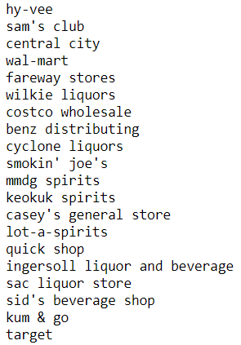
Deal with store_name (3)
From this process we managed to reduce the number of unique values to 300.

Slide 19
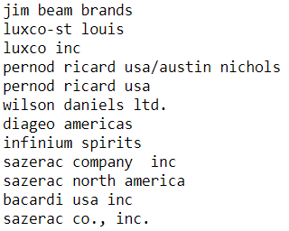
Deal with vendor_name (1)
For this case, this attribute has many duplicates in naming the instances. For example, one uses ‘and’ and the other with a same name uses ‘&’. Or one ends with ‘inc’ and the other with ‘inc.’ with a dot. As a result, the machine will treat these as different instances.

Slide 20
Deal with vendor_name (2)
df['vendor_name'] = df['vendor_name'].str.lower()
df['vendor_name'].loc[df.vendor_name.str.contains('luxco')] = 'luxco inc'
df['vendor_name'].loc[df.vendor_name.str.contains('pernod ricard usa')] = 'pernod ricard usa'
df['vendor_name'].loc[df.vendor_name.str.contains('gunsandmore')] = 'gunsandmore'
df['vendor_name'].loc[df.vendor_name.str.contains('mccormick distilling')] = 'mccormick distilling co'
df['vendor_name'].loc[df.vendor_name.str.contains('sazerac')] = 'sazerac company inc'
df['vendor_name'].loc[df.vendor_name.str.contains('mississippi river')] = 'mississippi river distilling co'
df['vendor_name'].loc[df.vendor_name.str.contains('phillips beverage')] = 'phillips beverage company'
df['vendor_name'].loc[df.vendor_name.str.contains('constellation')] = 'constellation wine company'
df['vendor_name'].loc[df.vendor_name.str.contains('william grant')] = 'william grant & sons inc'
df['vendor_name'].loc[df.vendor_name.str.contains('cedar ridge vineyards')] = 'cedar ridge vineyards llc'
df['vendor_name'].loc[df.vendor_name.str.contains('prestige wine')] = 'prestige wine & spirits group'
df['vendor_name'].loc[df.vendor_name.str.contains('ole smoky')] = 'ole smoky distillery'
df['vendor_name'].loc[df.vendor_name.str.contains('laird')] = 'laird & company'
df['vendor_name'].loc[df.vendor_name.str.contains('gallo winery')] = 'e & j gallo winery'
df['vendor_name'].loc[df.vendor_name.str.contains('s&b farms')] = 's&b farms distillery'
df['vendor_name'].loc[df.vendor_name.str.contains('fifth generation')] = 'fifth generation inc'
df['vendor_name'].loc[df.vendor_name.str.contains('yahara bay distillers')] = 'yahara bay distillers inc'
df['vendor_name'].loc[df.vendor_name.str.contains('bacardi')] = 'bacardi usa inc'
df['vendor_name'].loc[df.vendor_name.str.contains('forman')] = 'brown-forman corporation'
df['vendor_name'].loc[df.vendor_name.str.contains('dunkel corporation')] = 'dunkel corporation'

Slide 21
Lowercase Some Attributes
Some of the attributes have duplicate instances where one is capitalized and one is not. We can solve this problem by lowercasing all of the instances.
df['city'] = df['city'].str.lower()
df['county'] = df['county'].str.lower()
df['category_name'] = df['category_name'].str.lower()
df['item_description'] = df['item_description'].str.lower()

Slide 22
Drop Some Attributes
Lastly, we can drop the attributes that we think will not give much information.
df.drop(['invoice_and_item_number',
'date',
'store_number',
'address',
'county_number',
'category',
'vendor_number',
'item_number'], axis=1, inplace=True)

Slide 23
Data Visualization

Slide 24
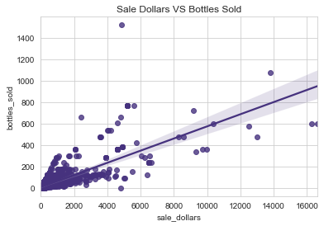
sale_dollars vs bottles_sold (1)
sns.regplot(x='sale_dollars', y='bottles_sold', data=df[df['sale_dollars'] < 20000])
plt.title('Sale Dollars VS Bottles Sold')

Slide 25
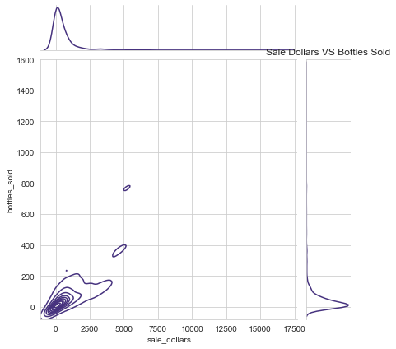
sale_dollars vs bottles_sold (2)
sns.jointplot(x='sale_dollars', y='bottles_sold',
data=df[df['sale_dollars'] < 20000],
kind='kde')
plt.title('Sale Dollars VS Bottles Sold')
The data is centered around few bottles and cheap price. It also has positive trend. The data had some outliers, so we will exclude those to get a better look at the plot.

Slide 26
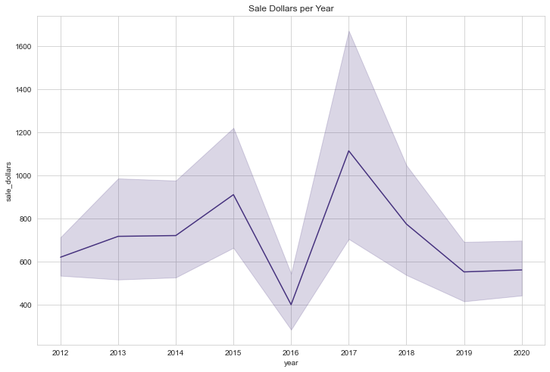
sale_dollars vs date object (1)
plt.figure(figsize=(12, 8))
sns.lineplot(x='year', y='sale_dollars', data=df)
plt.title('Sale Dollars per Year')

Slide 27
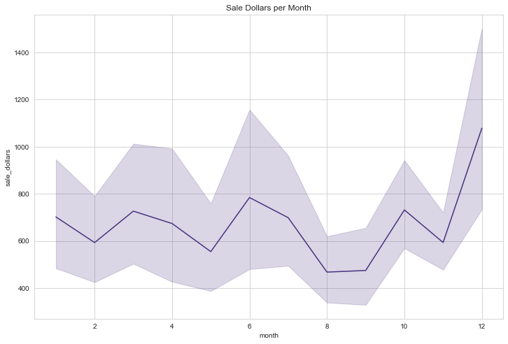
sale_dollars vs date object (2)
plt.figure(figsize=(12, 8))
sns.lineplot(x=‘month', y='sale_dollars', data=df)
plt.title('Sale Dollars per Month')

Slide 28
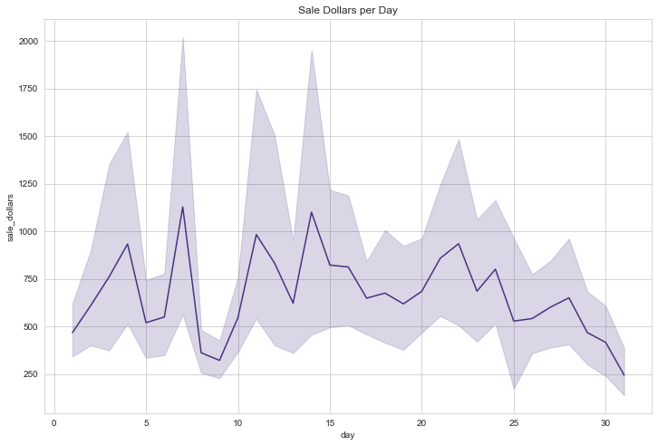
sale_dollars vs date object (3)
plt.figure(figsize=(12, 8))
sns.lineplot(x=‘day', y='sale_dollars', data=df)
plt.title('Sale Dollars per Day')

Slide 29
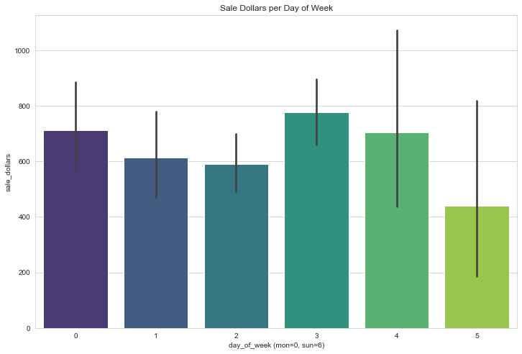
sale_dollars vs date object (3)
plt.figure(figsize=(12, 8))
sns.barplot(x='day_of_week', y='sale_dollars', data=df)
plt.title('Sale Dollars per Day of Week')
plt.xlabel('day_of_week (mon=0, sun=6)')
Why are there no Sundays in our data? There is a law in USA called Blue Law. Many states prohibit selling alcohol for on and off-premises sales in one form or another on Sundays at some restricted time, under the idea that people should be in church on Sunday morning, or at least not drinking.

Slide 30
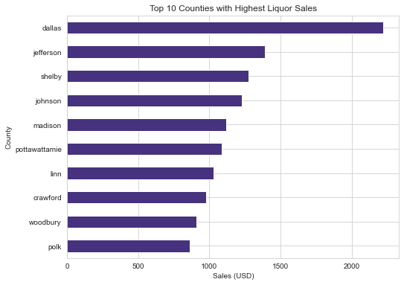
sale_dollars vs object attributes (1)
by_county = df.groupby('county').mean()
plt.figure(figsize=(8, 6))
by_county.sort_values('sale_dollars', ascending=True)['sale_dollars'].tail(10).plot(kind='barh')
plt.title('Top 10 Counties with Highest Liquor Sales')
plt.ylabel('County')
plt.xlabel('Sales (USD)')
plt.show();

Slide 31
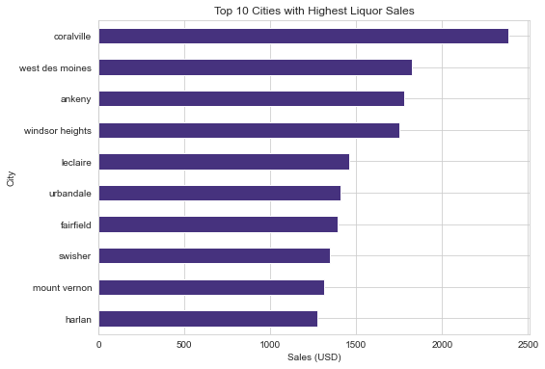
sale_dollars vs object attributes (2)

Slide 32
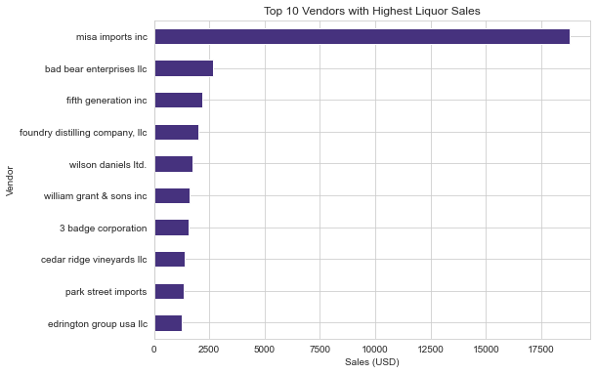
sale_dollars vs object attributes (3)

Slide 33
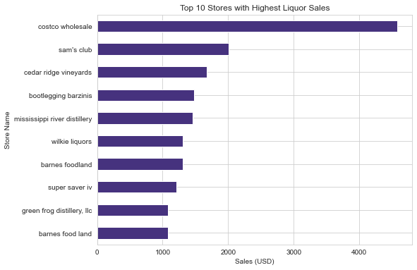
sale_dollars vs object attributes (4)

Slide 34
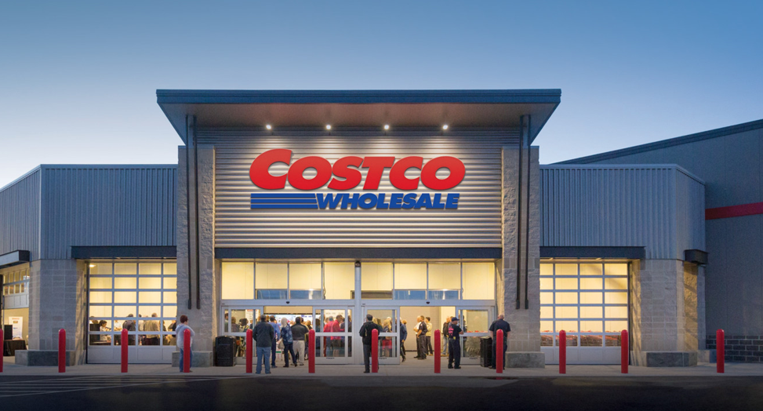
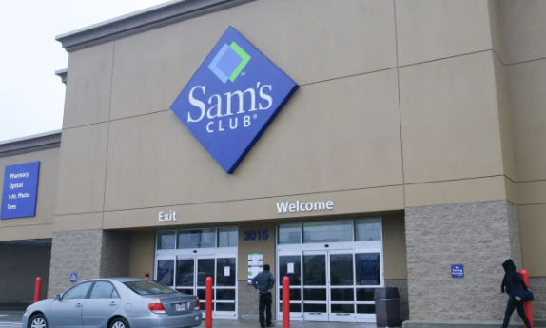
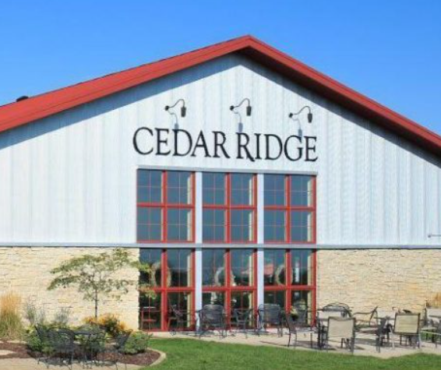



Slide 35
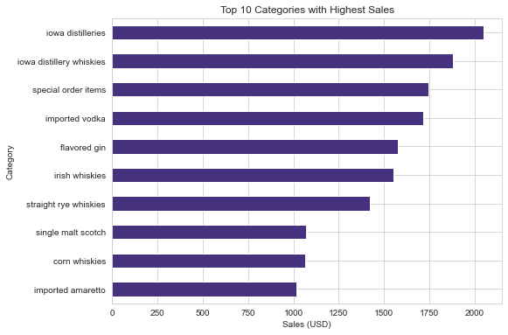
sale_dollars vs object attributes (5)

Slide 36
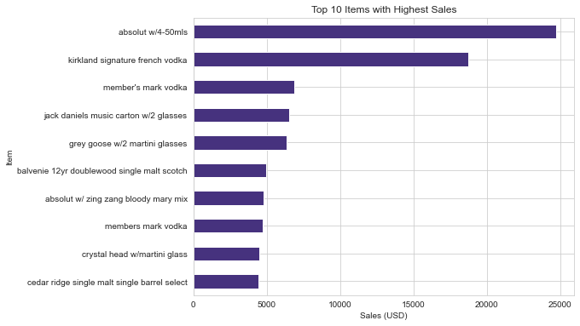
sale_dollars vs object attributes (5)

Slide 37
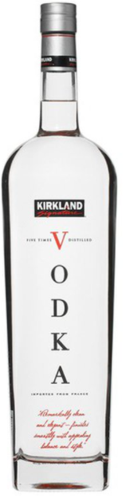
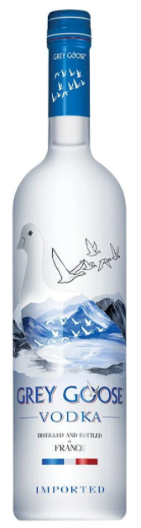
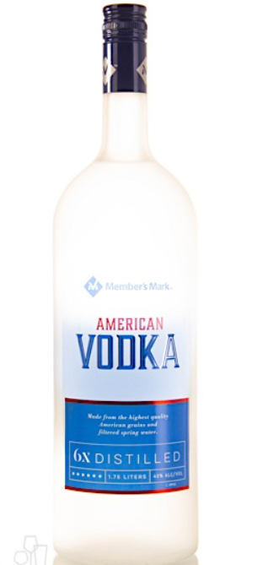

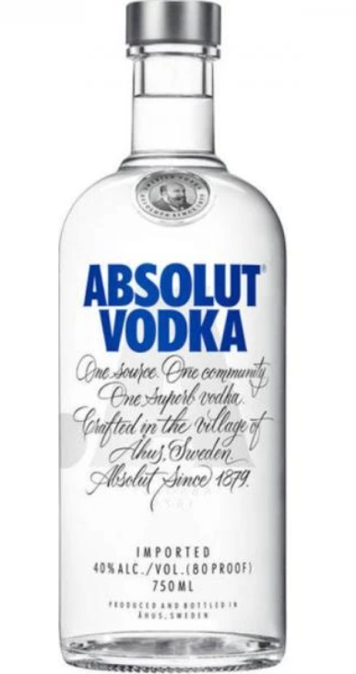

Slide 38
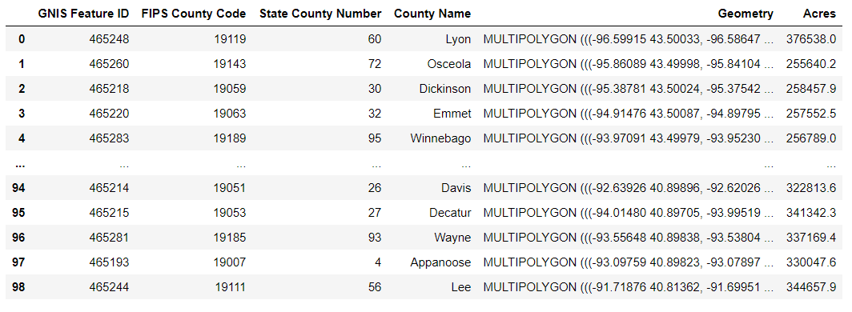
Mapping store_location (1)
The instances of this attribute has a format POINT (longitude, latitude). These will draw dots across the graph. But if it’s only the dots, we won’t know what will those represent. We will need an additional data which will draw a map border, especially Iowa counties’.
The MULTIPOLYGON will draw the map boundary for us.

Slide 39
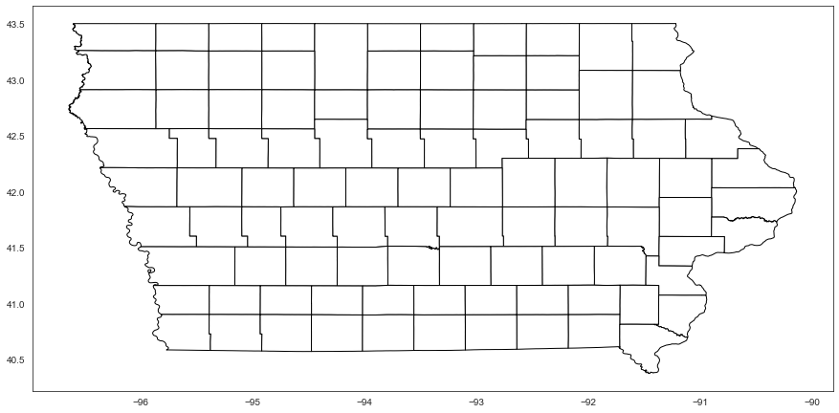
Mapping store_location (2)
from shapely import wkt
iowa['Geometry'] = iowa['Geometry'].apply(wkt.loads)
iowa.set_geometry('Geometry').plot(figsize=(15, 15), color='white', edgecolor='black')

Slide 40
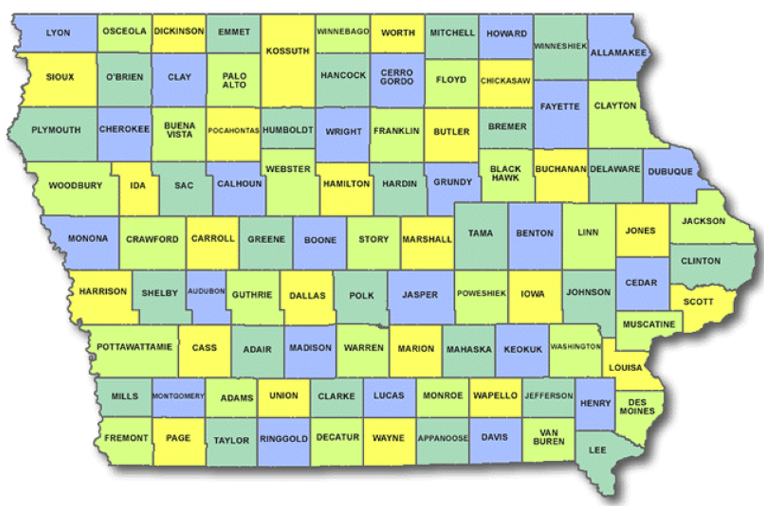
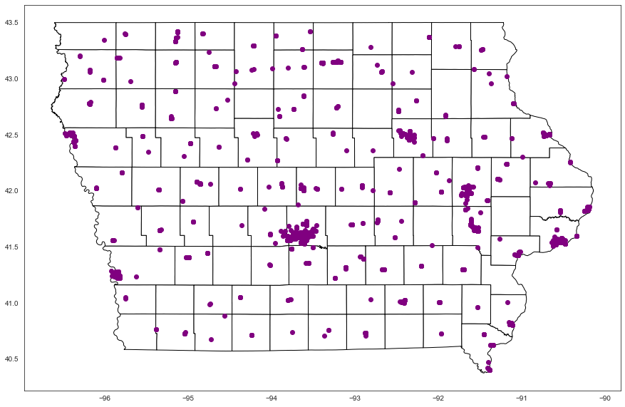
coord = df['store_location'].str.strip().str[7:-1]
x = coord.str.split(' ').str[0]
y = coord.str.split(' ').str[1]
geo_df = gpd.GeoDataFrame(df, crs={'init':'epsg:4326'}, geometry=gpd.points_from_xy(x, y))
plt.figure(figsize=(15, 8))
ax = iowa.set_geometry('Geometry').plot(figsize=(15, 15), color='white', edgecolor='black')
geo_df.plot(ax=ax, color='purple')
plt.show()

Slide 41
Mapping store_location (3)
Even though most stores are located in Polk, it doesn’t have the highest liquor sales.

Slide 42
Regression Model

Slide 43
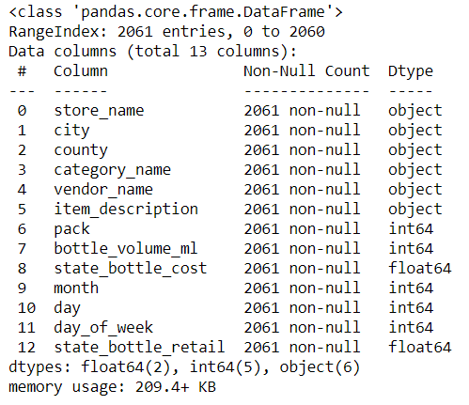
Choosing the Attributes
From the cleaned data that we have, we will try to build a simple regression model based on the state_bottle_retail. The attributes for the training are store_name, city, county, category_name, vendor_name, item_description, pack, bottle_volume_ml, state_bottle_cost, month, day, day_of_week.

Slide 44
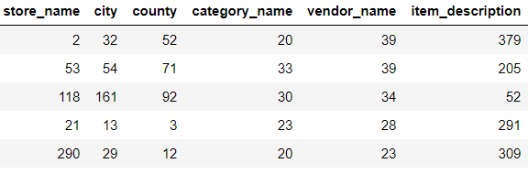
Deal with Categorical Variables
There is still a problem. To feed the data into a regression model, it needs to be in numerical. So to solve this problem, we need to convert the object attributes into categorical.
for label, content in data.items():
if pd.api.types.is_string_dtype(content):
data[label] = content.astype('category').cat.as_ordered()
for label, content in data.items():
if not pd.api.types.is_numeric_dtype(content):
data[label] = pd.Categorical(content).codes

Slide 45
Split into Train and Test Sets
We will try to predict the retail price, so let’s assign the attribute as y and the others as X.
X = data.drop('state_bottle_retail', axis=1)
y = data['state_bottle_retail']
Next we split it further into X_train, X_test, y_train, and y_test. We will use 30% of our data for validation. The value of random_state is an arbitrary number and need to be stated for reproducible results.
from sklearn.model_selection import train_test_split
X_train, X_test, y_train, y_test = train_test_split(X, y, test_size=0.3, random_state=101)

Slide 46
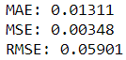
Train the Model (Linear Regression)
We will compare 2 regression models: linear regression and random forest regression. First we will train linear regression.
from sklearn.linear_model import LinearRegression
from sklearn.metrics import mean_absolute_error, mean_squared_error
lr = LinearRegression(n_jobs=1)
lr.fit(X_train, y_train)
lr_preds = lr.predict(X_test)
print(f'MAE: {mean_absolute_error(y_test, lr_preds):.5f}')
print(f'MSE: {mean_squared_error(y_test, lr_preds):.5f}')
print(f'RMSE: {np.sqrt(mean_squared_error(y_test, lr_preds)):.5f}')

Slide 47
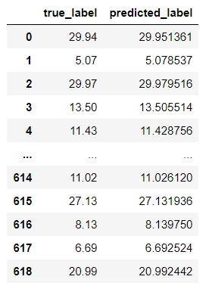
Train the Model (Linear Regression)
lr_preds = pd.Series(lr_preds)
y_test = y_test.reset_index(drop=True)
pd.DataFrame({'true_label':y_test, 'predicted_label':lr_preds})
Our linear regression model did an excellent job. The predictions come really close with the actual label with 0.05901 RMSE.

Slide 48
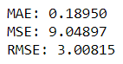
Train the Model (Random Forest Regression)
Next we will train random forest regression.
from sklearn.ensemble import RandomForestRegressor
from sklearn.metrics import mean_absolute_error, mean_squared_error
rf = RandomForestRegressor()
rf.fit(X_train, y_train)
rf_preds = rf.predict(X_test)
print(f'MAE: {mean_absolute_error(y_test, lr_preds):.5f}')
print(f'MSE: {mean_squared_error(y_test, lr_preds):.5f}')
print(f'RMSE: {np.sqrt(mean_squared_error(y_test, lr_preds)):.5f}')

Slide 49
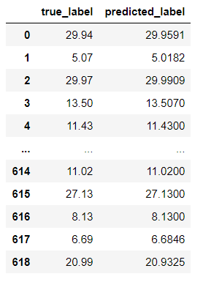
Train the Model (Random Forest Regression)
rf_preds = pd.Series(rf_preds)
y_test = y_test.reset_index(drop=True)
pd.DataFrame({'true_label':y_test, 'predicted_label':rf_preds})
Our random forest regression model also did an excellent job. The predictions come really close with the actual label with 3.00815 RMSE.

Slide 50
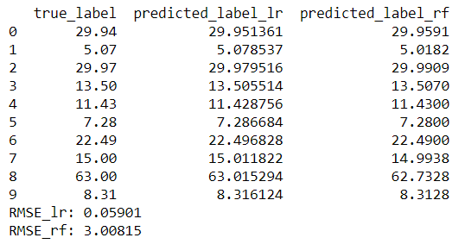
print(pd.DataFrame({'true_label':y_test,
'predicted_label_lr':lr_preds,
'predicted_label_rf':rf_preds}).head(10))
print(f'RMSE_lr: {np.sqrt(mean_squared_error(y_test, lr_preds)):.5f}')
print(f'RMSE_rf: {np.sqrt(mean_squared_error(y_test, rf_preds)):.5f}')
When we compare them side by side, looks like out of the two models with no hyperparameter tuning, our linear regression model performs better. Let's save this model.
import joblib
joblib.dump(lr, 'lr_model.joblib')

Slide 51
New Data

Slide 52
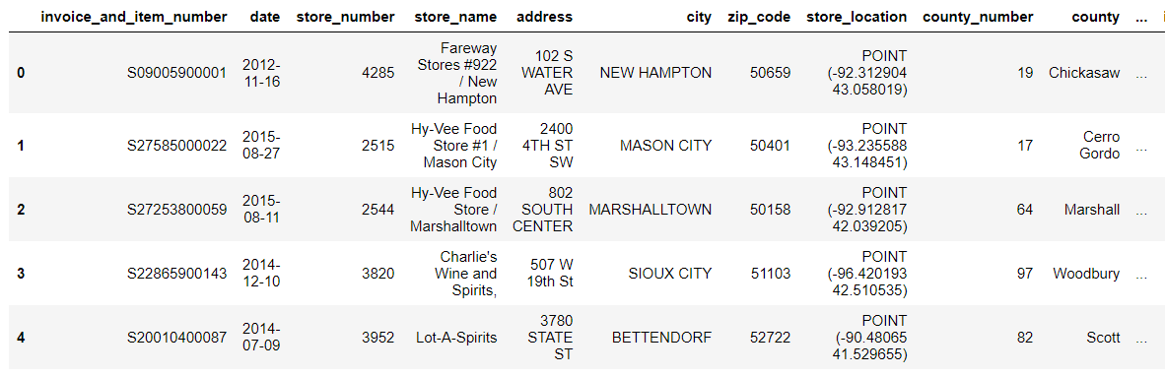
Get the Data
Now that we have built our model, what if we want to predict a brand new data that the machine has never seen before?
We will get more or less 600 random samples from the original dataset.
Because this is a brand new data, we have to do preprocessing like we did in our data model so that it will perfectly match with our model.

Slide 53
Preprocessing (1)
1. Drop the missing values
df.dropna(inplace=True)
2. Extract year, month, day, and dayofweek from date
df['date'] = pd.to_datetime(df['date'])
df['year'] = df['date'].apply(lambda x: x.year)
df['month'] = df['date'].apply(lambda x: x.month)
df['day'] = df['date'].apply(lambda x: x.day)
df['day_of_week'] = df['date'].apply(lambda x: x.dayofweek)
3. Drop some attributes
df.drop(['invoice_and_item_number', 'date', 'store_number', 'address', 'county_number', 'category', 'vendor_number', 'item_number'], axis=1, inplace=True)

Slide 54
Preprocessing (2)
4. Lowercase some attributes
df['city'] = df['city'].str.lower()
df['county'] = df['county'].str.lower()
df['category_name'] = df['category_name'].str.lower()
df['item_description'] = df['item_description'].str.lower())
5. Deal with store_name
df['store_name'] = df['store_name'].str.lower()
df['store_name'] = df['store_name'].str.split(' / ').str[0]
df['store_name'] = df['store_name'].str.split('/').str[0]
df['store_name'] = df['store_name'].str.split(' #').str[0]
df['store_name'].loc[df.store_name.str.contains('hy-vee')] = 'hy-vee'
df['store_name'].loc[df.store_name.str.contains('central city')] = 'central city'
df['store_name'].loc[df.store_name.str.contains("sam's club")] = "sam's club"
df['store_name'].loc[df.store_name.str.contains('wal-mart')] = 'wal-mart'
df['store_name'].loc[df.store_name.str.contains('target')] = 'target'
df['store_name'].loc[df.store_name.str.contains('world liquor')] = 'world liquor & tobacco + vape'

Slide 55
Preprocessing (3)
6. Deal with vendor_name
df['vendor_name'] = df['vendor_name'].str.lower()
df['vendor_name'].loc[df.vendor_name.str.contains('luxco')] = 'luxco inc'
df['vendor_name'].loc[df.vendor_name.str.contains('pernod ricard usa')] = 'pernod ricard usa'
df['vendor_name'].loc[df.vendor_name.str.contains('gunsandmore')] = 'gunsandmore'
df['vendor_name'].loc[df.vendor_name.str.contains('mccormick distilling')] = 'mccormick distilling co'
df['vendor_name'].loc[df.vendor_name.str.contains('sazerac')] = 'sazerac company inc'
df['vendor_name'].loc[df.vendor_name.str.contains('mississippi river')] = 'mississippi river distilling co'
df['vendor_name'].loc[df.vendor_name.str.contains('phillips beverage')] = 'phillips beverage company'
df['vendor_name'].loc[df.vendor_name.str.contains('constellation')] = 'constellation wine company'
df['vendor_name'].loc[df.vendor_name.str.contains('william grant')] = 'william grant & sons inc'
df['vendor_name'].loc[df.vendor_name.str.contains('cedar ridge vineyards')] = 'cedar ridge vineyards llc'
df['vendor_name'].loc[df.vendor_name.str.contains('prestige wine')] = 'prestige wine & spirits group'
df['vendor_name'].loc[df.vendor_name.str.contains('ole smoky')] = 'ole smoky distillery'
df['vendor_name'].loc[df.vendor_name.str.contains('laird')] = 'laird & company'
df['vendor_name'].loc[df.vendor_name.str.contains('gallo winery')] = 'e & j gallo winery'
df['vendor_name'].loc[df.vendor_name.str.contains('s&b farms')] = 's&b farms distillery'
df['vendor_name'].loc[df.vendor_name.str.contains('fifth generation')] = 'fifth generation inc'
df['vendor_name'].loc[df.vendor_name.str.contains('yahara bay distillers')] = 'yahara bay distillers inc'
df['vendor_name'].loc[df.vendor_name.str.contains('bacardi')] = 'bacardi usa inc'
df['vendor_name'].loc[df.vendor_name.str.contains('forman')] = 'brown-forman corporation'
df['vendor_name'].loc[df.vendor_name.str.contains('dunkel corporation')] = 'dunkel corporation'

Slide 56
Preprocessing (4)
7. Deal with categorical variables
data = df[['store_name', 'city', 'county', 'category_name', 'vendor_name', 'item_description', 'pack', 'bottle_volume_ml', 'state_bottle_cost', 'month', 'day', 'day_of_week', 'state_bottle_retail’]]
for label, content in data.items():
if pd.api.types.is_string_dtype(content):
data[label] = content.astype('category').cat.as_ordered()
for label, content in data.items():
if not pd.api.types.is_numeric_dtype(content):
data[label] = pd.Categorical(content).codes
8. And lastly, drop the label column
data.drop('state_bottle_retail', axis=1, inplace=True)

Slide 57
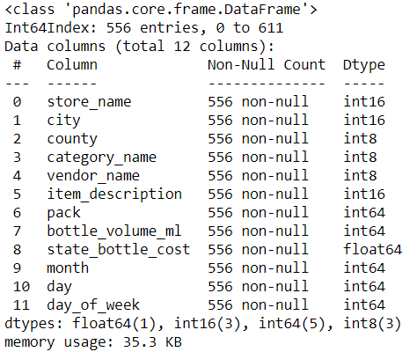
Preprocessing (5)
Our test data is now ready. Let's load our saved model.

Slide 58
Load Saved Model
import joblib
model = joblib.load('lr_model.joblib')

Slide 59
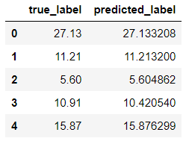
Predict the Test Data
preds = model.predict(data)
preds = pd.Series(preds)
pd.DataFrame({'true_label':df['state_bottle_retail'], 'predicted_label':preds}).head()

Slide 60
Closing

Slide 61
Conclusions
Year 2017 had the highest sales and 2016 had the lowest
Most bottles were sold on December, probably in the winter
The middle of the month had the average high sales
Weekdays were the ideal days to sell liquors
Most stores are located in Polk County, but the highest sales were in Dallas County
Vodkas were customers’ favorite
Linear regression model performed better with 0.05901 RMSE than random forest regression with 3.00815 RMSE.

Slide 62
Suggestions
The data has so many inconsistencies, especially the instances of object attributes. Some are capitalized, some are not. Some use ‘&’, some use ‘and’. Some have a comma, some don’t. As a result, there are quite numbers of duplicates.
My personal suggestion is while inputting the strings for these attributes, using drop-down would be better than manually typing them, which I assumed is the case.

Slide 63
Thank You
By Jafar Shodiq
j.shodiq2312@gmail.com | +6281382378203 | jafarshodiq.pythonanywhere.com

